Slide 1

Université de Mostaganem — Dr. Madani BELACEL
TIC COURSE 03
The Windows Operating System
Dr. BELACEL Madani
Année universitaire 2026-2027 / Academic Year 2026-2027
Université de Mostaganem - Département Mathématiques et Informatique

Slide 2
Université de Mostaganem — Dr. Madani BELACEL
Course Outline
▪ 1. Role of the Operating System
▪ 2. Windows Overview
▪ 3. Desktop and Taskbar
▪ 4. Managing Files and Folders
▪ 5. Settings and Personalization
▪ 6. Useful Keyboard Shortcuts
▪ 7. Maintenance and Security

Slide 3
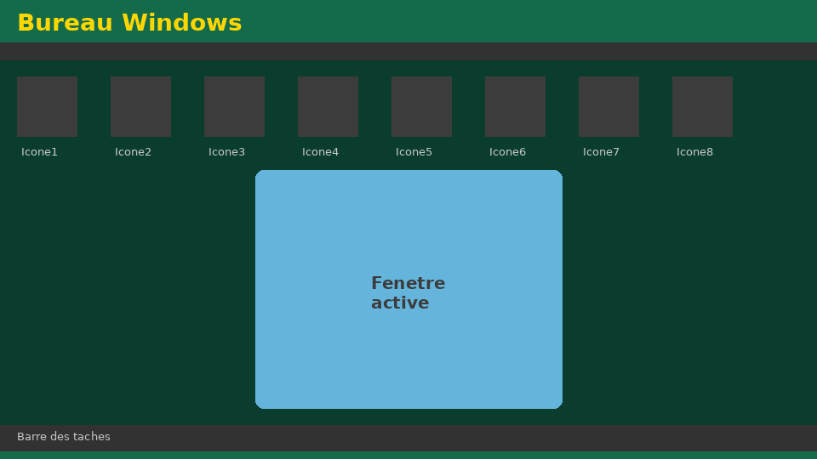
Université de Mostaganem — Dr. Madani BELACEL
Section 1
Role of the Operating System

Slide 4
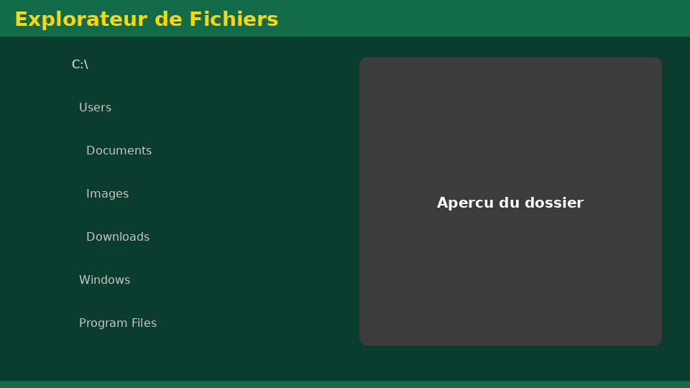
Université de Mostaganem — Dr. Madani BELACEL
1 - Role of the Operating System
▪ Intermediate layer between user and hardware.
▪ Manages CPU, memory, files and peripherals.
▪ Provides a friendly graphical interface (GUI).
▪ Examples: Windows, Linux, macOS, Android, iOS.

Slide 5
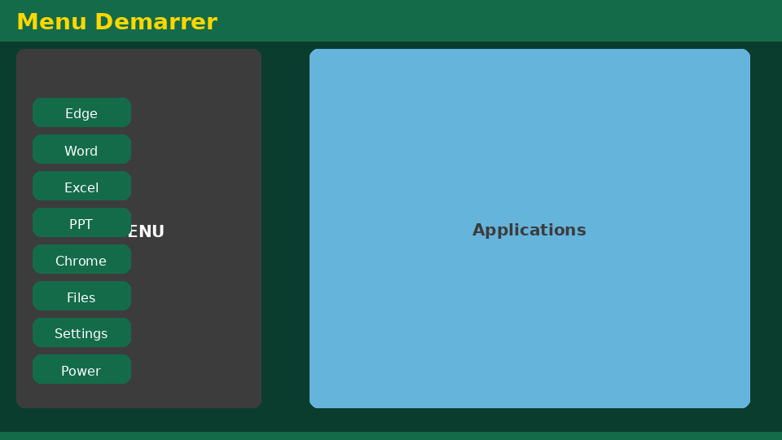
Université de Mostaganem — Dr. Madani BELACEL
Section 2
Windows Overview

Slide 6
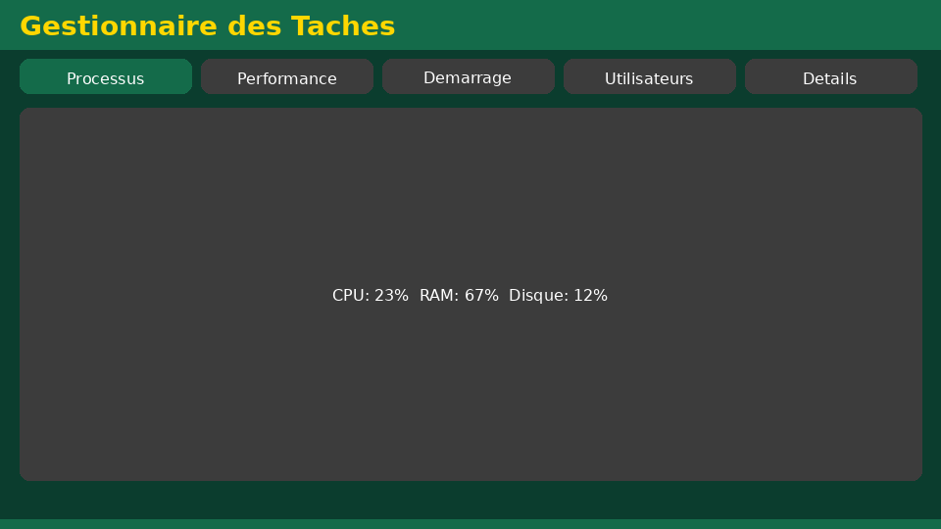
Université de Mostaganem — Dr. Madani BELACEL
2 - Windows Overview
▪ Developed by Microsoft since 1985.
▪ Versions: XP, 7, 8, 10, 11.
▪ Graphical interface: windows, icons, menus, pointer (WIMP).
▪ Multitasking and multi-user.

Slide 7
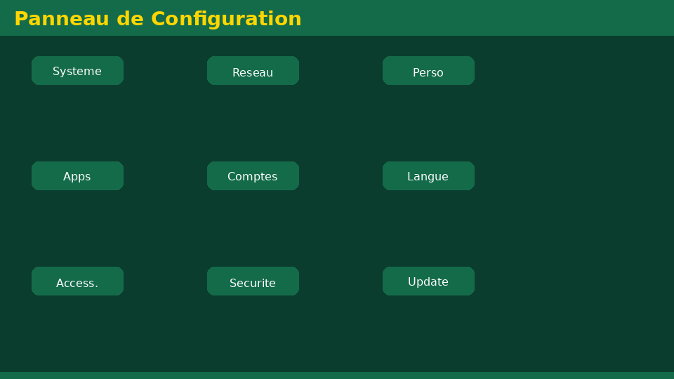
Université de Mostaganem — Dr. Madani BELACEL
Section 3
Desktop and Taskbar

Slide 8
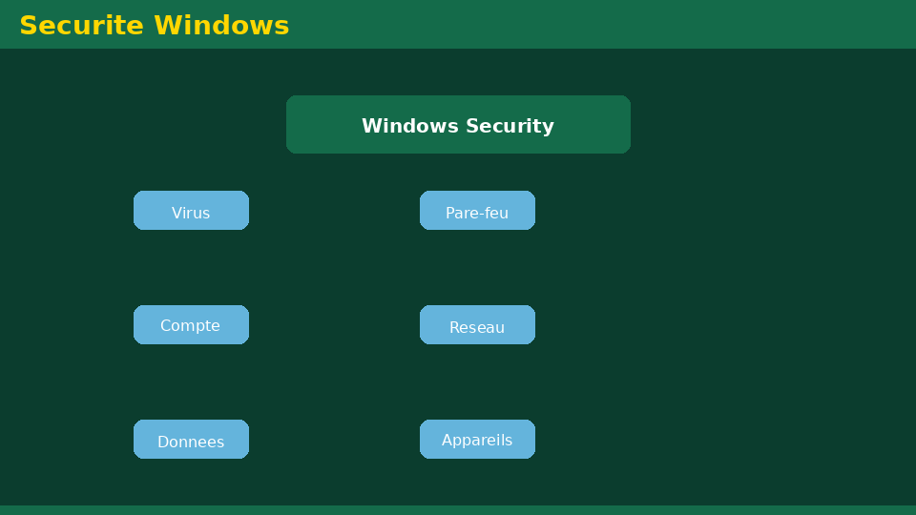
Université de Mostaganem — Dr. Madani BELACEL
3 - Desktop and Taskbar
▪ Desktop: main workspace with icons and shortcuts.
▪ Taskbar: open applications and notification area.
▪ Start menu: access to programs and settings.
▪ Recycle Bin: restore or permanently delete files.

Slide 9
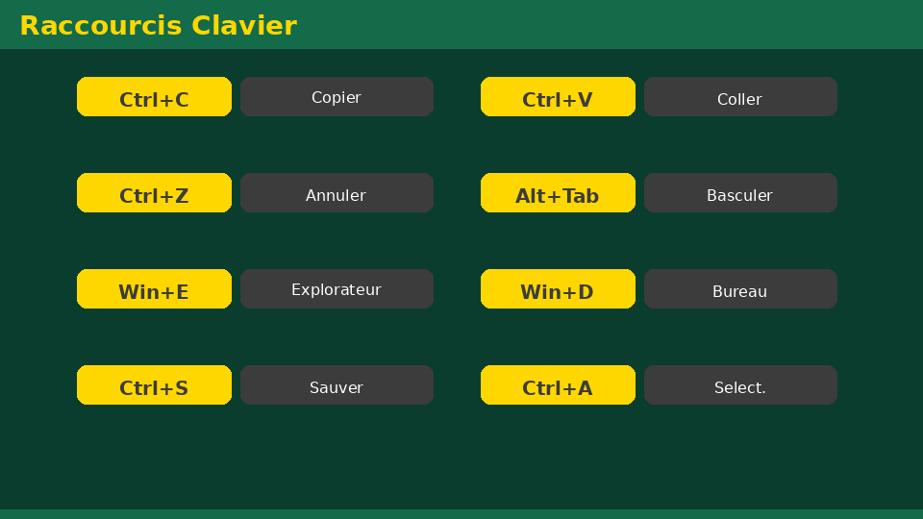
Université de Mostaganem — Dr. Madani BELACEL
Section 4
Managing Files and Folders

Slide 10
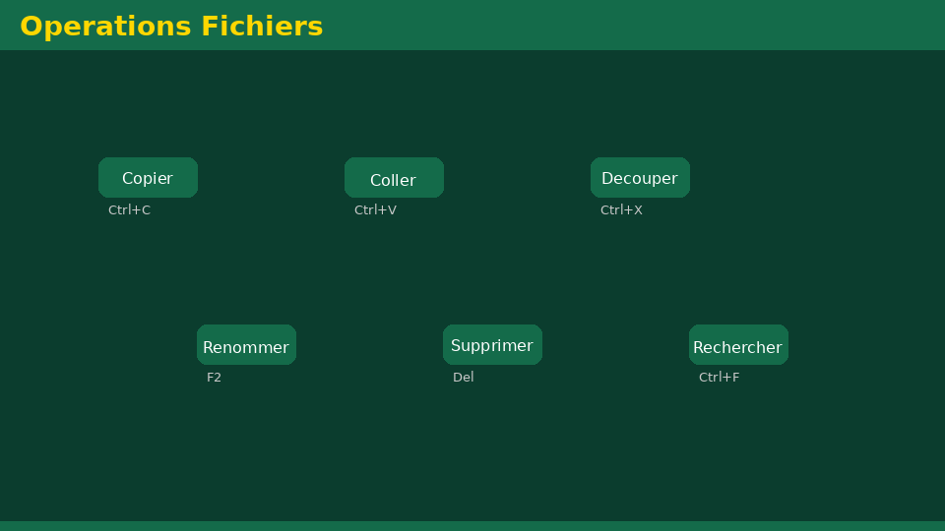
Université de Mostaganem — Dr. Madani BELACEL
4 - Managing Files and Folders
▪ Hierarchy: drive > folder > subfolder > file.
▪ File Explorer: browsing and organizing.
▪ Operations: create, copy, move, rename, delete.
▪ Extensions: .txt, .docx, .xlsx, .pdf, .jpg, .exe.
▪ Searching and sorting files.

Slide 11
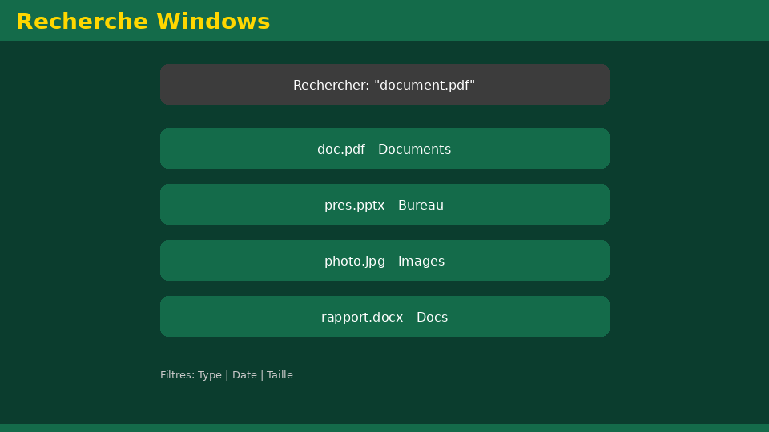
Université de Mostaganem — Dr. Madani BELACEL
Section 5
Settings and Personalization

Slide 12
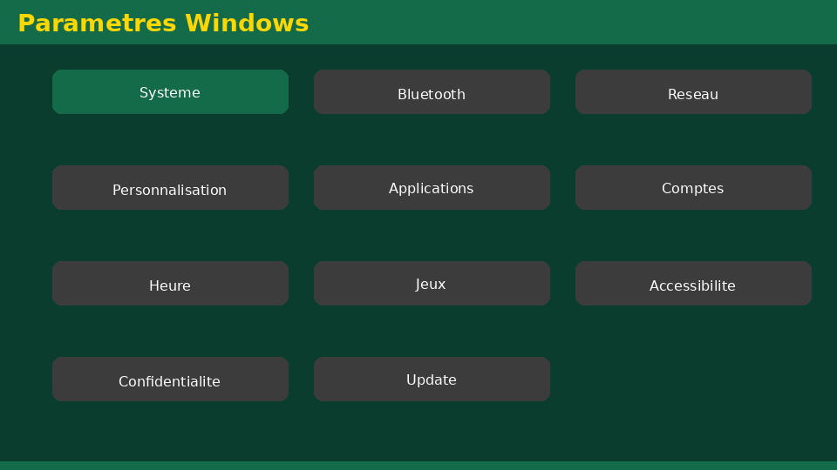
Université de Mostaganem — Dr. Madani BELACEL
5 - Settings and Personalization
▪ Control Panel / Settings: system configuration.
▪ Personalization: wallpaper, theme, colors.
▪ User accounts: administrator vs standard user.
▪ Date/time, language, keyboard, display and sound.

Slide 13
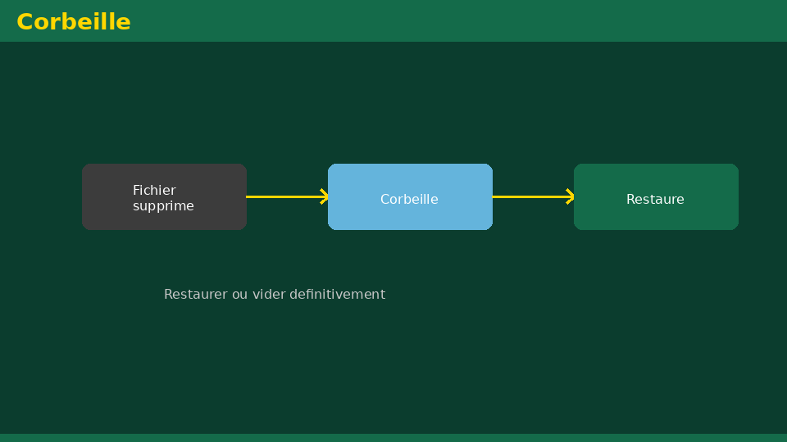
Université de Mostaganem — Dr. Madani BELACEL
Section 6
Useful Keyboard Shortcuts

Slide 14
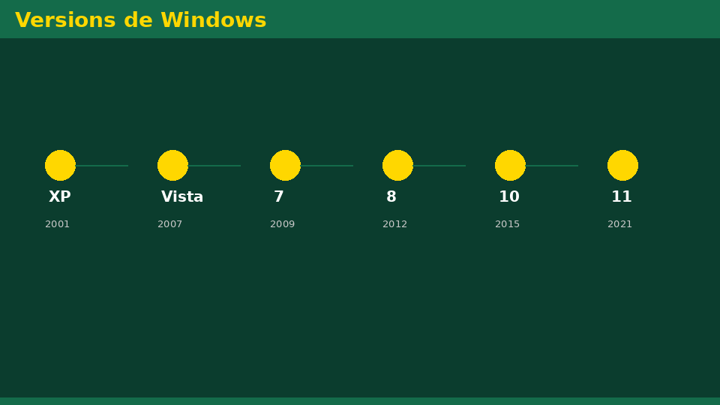
Université de Mostaganem — Dr. Madani BELACEL
6 - Useful Keyboard Shortcuts
▪ Ctrl+C / Ctrl+X / Ctrl+V: copy / cut / paste.
▪ Ctrl+Z: undo; Ctrl+S: save.
▪ Alt+Tab: switch between windows.
▪ Win+D: show desktop; Win+E: file explorer.
▪ Ctrl+Alt+Del: task manager.

Slide 15
Université de Mostaganem — Dr. Madani BELACEL
Section 7
Maintenance and Security

Slide 16
Université de Mostaganem — Dr. Madani BELACEL
7 - Maintenance and Security
▪ Regular updates via Windows Update.
▪ Antivirus: protection against viruses and malware.
▪ Disk cleanup and defragmentation.
▪ Backing up important data.
▪ Task Manager: monitoring processes.

Slide 17
Université de Mostaganem — Dr. Madani BELACEL
Practical Interest
▪ Organize course documents efficiently in folders.
▪ Use shortcuts to work faster.
▪ Fix a frozen PC with the task manager.
▪ Secure your data: password, backups, antivirus.

Slide 18
Université de Mostaganem — Dr. Madani BELACEL
Self-Assessment (MCQ)
1. What is the main role of an OS?
a) Drawing pictures
b) Managing hardware and software
c) Only connecting to the Internet
2. Which extension belongs to a Word document?
a) .xlsx
b) .docx
c) .mp3
3. Ctrl+Z is used to:
a) Copy
b) Undo
c) Paste

Slide 19
Université de Mostaganem — Dr. Madani BELACEL
Conclusion
▪ Windows provides a simple yet powerful graphical interface.
▪ Mastering files, folders and shortcuts is essential.
▪ Good maintenance ensures performance and security.
▪ Next course: Microsoft Word word processing.

Slide 20
Université de Mostaganem — Dr. Madani BELACEL
References
- Microsoft Support - Windows 10/11 documentation.
- "Windows 10 for Dummies", Wiley.
- ICT Course materials, University of Mostaganem.
- support.microsoft.com

Slide 21
Université de Mostaganem — Dr. Madani BELACEL
Thank you for your attention!
Questions?
Dr. BELACEL Madani

